Slide 1
INFM-600 | Fall 2019
Will the poor foot the bill for Global Warming?
Team Wolf Pack ZEL

Slide 2

Key definitions and brief findings from research
Project scope and adjustments
Stakeholders
Data Prep & Analysis
Data Visualization in Tableau Dashboard
Findings & Implications
Lessons Learned

Slide 3
Introduction & Key Definitions
The Problem We Examined
Global warming is a symptom of climate change that is characterized by the long-term rise in the average temperature of the Earth's climate system. Other Climate change vital signs are, warming oceans, shrinking ice sheets, glacial retreat, decreased snow cover, sea-level rise, declining Arctic Sea ice, and other Extreme events. (www.climate.gov)
Industry research suggests that 95% of global warming is caused by carbon dioxide and other human-made emissions. NASA estimates an upward shift of 1.67 degrees since the late 19th century. (Mostly concentrated in the last 35 years). www.climate.nasa.com
Research refers to what is called the economic injustice of global warming the trend that shows that poorer countries are the most affected by global warming. Poorer countries are generally in warmer regions, which make it easier for them to suffer for any rise in temperature increases that lead to devastation.

Slide 4
Project Description
Where we started
We originally wanted to explore the correlation between temperature, time and location in regards to our topic of Global Warming. Our original scope focused on all major cities and countries in the world, and their changes in temperature spanning over 265 years.
Some questions we originally wanted to explore:
What is the average temperature of each country over the past 40 years?
Which countries experience the highest temperature degree over the past 40 years?
What are the temperature trends in the major cities?
How are the latitudes and longitudes of the countries affect their climate change?
What we refined
We soon realized we needed to change our research scope to narrow our focus on particular countries and a smaller timespan - we went from the original 5 datasets to choosing one dataset that had all relevant information for the selected countries (temperature, location and time). We used external GDP dataset as a reference to find out richest and poorest countries according to 2013 GDP and used that information as a filter in our dataset. We have also explored the top 5 highly affected countries.

Slide 5
Project Description (Continued)
Updated Project Goal
Is there a correlation between global climate change and poverty?
Our Hypothesis
After conducting scholarly research, we suspected there is a correlation between economic growth and changes in temperature. In existing research, we found heavy focus on potential future impacts. A Stanford study concluded findings that demonstrate that changes in temperature have “substantially shaped economic growth in both rich and poor countries over the last half century, and that future warming is likely to reduce global economic output, relative to a world without climate change.”[source] Although we aren’t the first to research this hypothesis, what intrigued us is whether or not the 5 countries with high GDPs and 5 countries with low GDPs would indeed have the lowest and highest impact in temperature change over the last 40 years.

Slide 6
Project Goals & Methods
Goals:
Determine if the top 5 with low GDP countries were affected the most by global climate change
Determine if the top 5 with high GDP countries were affected the least by global climate change
Determine if there are countries that were most and least affected by global climate change that are not considered the top 5 poorest or richest
Methods:
Statistical and quantitative approach to merge, cleanse and analyze temperatures, location over a set time period
Datasets:
GDP
Climate Change By Country
Repository:
GitHub Repository

Slide 7
Stakeholders
Stakeholders are those who have a potential impact and interest in global climate change, including but not limited to:
Environmental Scientists who do the work to identify, control, and eliminate factors that affect the environment (eg.: Sustainable farming studies)
Policymakers who make socio-economic decisions that affect the livelihoods of people and the resilience of the planet (eg.: Ratification of climate treaties and protocols)
Everyone! The earth is currently the only habitable planet and its resources should be protected and sustained.

Slide 8
Countries Selection
Focused on the top 5 poorest and 5 richest countries based on 2013 GDP in GDP dataset:
The 5 with low GDP countries: Kiribati, Tonga, Dominican Republic, American Samoa and Grenada.
The 5 with high GDP Countries: United States, China, Japan, Germany and France.
Focused on the 5 countries that were affected the most by global climate change:
United Arab Emirates, Yemen, Nigeria, Kiribati, Haiti
*Kiribati is already in poorest countries, thus was excluded from highly affected countries
[source]

Slide 9
Data Cleansing & Analysis
Datasets:
A climate change dataset (5 file sets): data from 1770s through 2013
GDP dataset: data from 1960s through 2018
Used GDP data set to find the 5 countries with high GDPs and 5 countries with low GDPs in 2013.
We concluded our refined research topic by referring to result from GDP data set to filter out data from “GlobalLandTemperaturesByCountry” file of climate change data set which included all the necessary information.
Used Python programming language in the Jupyter notebook to clean, concat and reshape the data
Removed the parenthesis from values and aggregated the rows.
Changed data types (e.g., objects to datetime)
Reshaped the whole GDP dataset to be readable.
Used Tableau to create the graphs and visualize the story

Slide 10
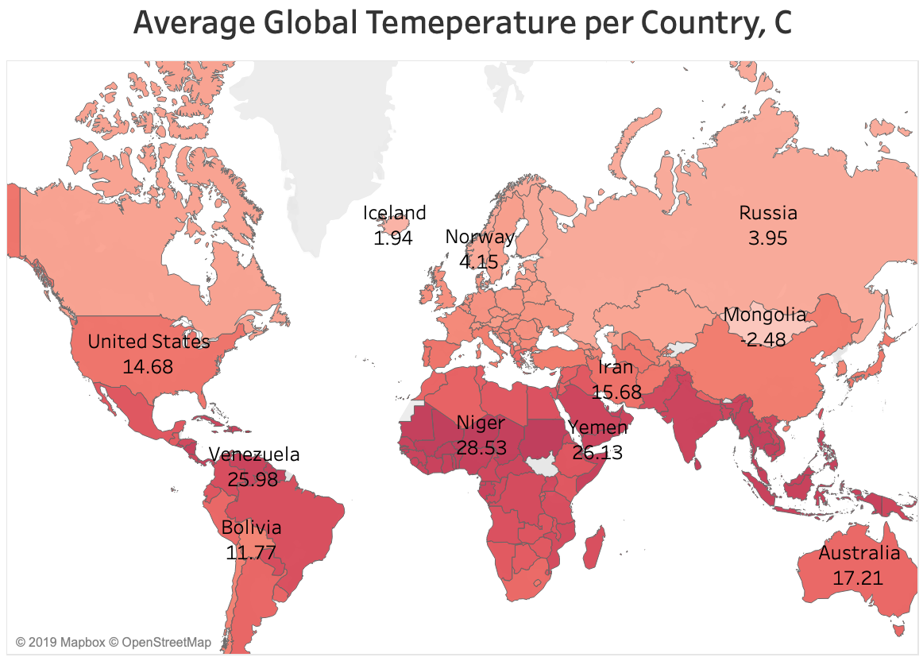
Key Insights & Findings (1)
1. The range of average temperature of countries in the world from 1743 to 2013 was concluded to be -2.48 degree celsius as lowest to 29.51 degree celsius as the highest.

Slide 11
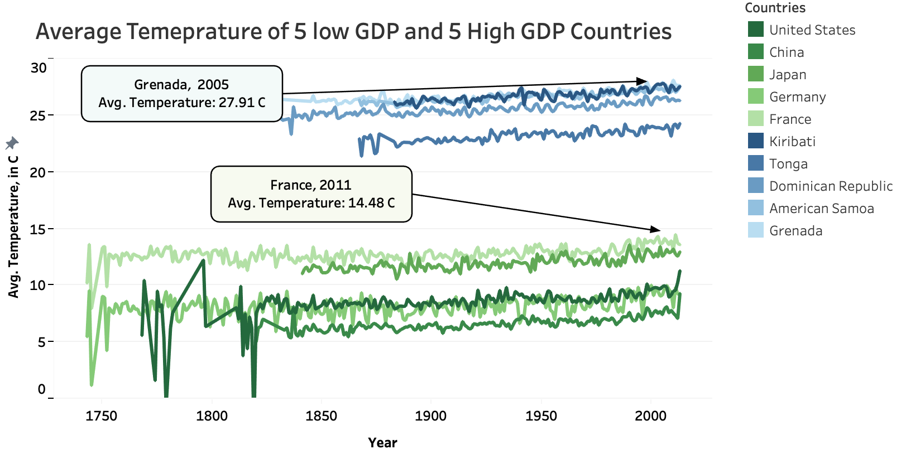
Key Insights & Findings (2)
2. It was found that there is a direct correlation between GDP of countries and climate change , according to the dataset the countries with lower GDPs had higher temperature over the years as compared to the countries with higher GDPs .

Slide 12
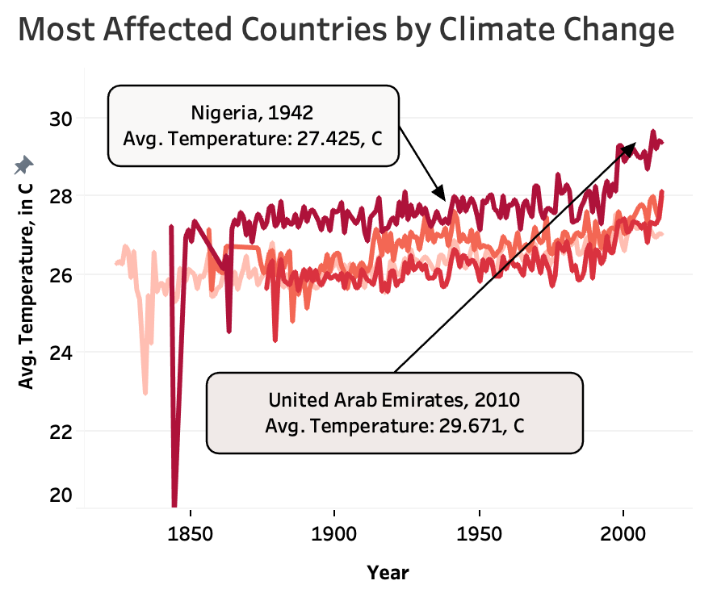
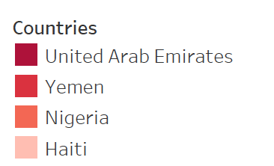
Key Insights & Findings (3)
3. The countries which mainly depend on water resources as their main source of income (e.g.Haiti) and the countries which have water scarcity (e.g. UAE) were affected the most by climate change in the last 10 years.

Slide 13
Implications
Based on the graphs we have created, we can confidently conclude that the there is a correlation between the GDPs and climate change.
The 5 countries with high GDPs had the lower temperatures as compared to countries with low GDPs.
There is a significant difference among the average temperatures between the poorest and richest countries. The difference is around 13 degrees.
United Arab Emirates and Nigeria are two of the most affected countries, and have the highest average temperatures comparing to the 3 other affected countries.
It was clearly shown in the map graph that the countries near equator have experience higher temperature.
It has been observed that there was a high average temperature spike in 1830s
Notes:
Although we did not find a direct correlation that the poorest countries were affected the most and the richest countries were affected the least in regards to global climate change over the last 40 years, we concluded poor countries were still most affected (just not the top 5 as we originally predicted).

Slide 14
Recommendations to Stakeholders
As we found a direct correlation that the poorest countries were affected the more than the richest countries were in regards to global climate change over the last 40 years, we encourage action for: awareness and behavior change towards climate change
Create a series of case studies and proposals for best practices - it’s important to use various mediums for vulnerable and poor populations that may not have access to the web/technology
Create awareness-raising programs that promote an understand of what climate change is and how to limit its cause and effect - what can we do from afar (in average to rich countries to help those located in poor and affected countries)
Resource

Slide 15
Lessons Learned
Changing scope
As the project progresses there are opportunities to explore topics that were not part of the original plan. Flexibility in change of scope is key.
Team Meeting
There are many online tools that can help with scheduling for individuals with loaded schedules. Doing this ahead of time helps to avoid rushed work
Sources for Data
For any topic, it is important to do a literature review in order to identify relevant sources from trusted institutions.
Team Knowledge
Determining which key skills each team member has allows for better cooperation and to better use the knowledge at hand.
Notes:
We had to examine the data a lot more closely to see the insights that were possible, and supplemented that with other information and data from relevant sources such as the World Bank information on GDP.
Due to the varying degrees of availability of team members, it proved difficult in the beginning to coordinate in-person meeting. We ended up using a mixture of in-person and online collaborative meetings using scheduling tools such as WhenToMeet and Google Hangouts.
We picked a topic that is controversial and that a lot of people do not have the same views on. In order to support the inferences we were making from our dataset, we had to resort to doing literature review using credible sources like NASA and the World Bank Group to get accurate information. We found that research was a key component to our project.
Our team has members who have a variety of skill sets. It was key to identify our strengths from the get go so that we are leveraging each one’s capabilities.

Slide 16
Limitations & Future Work
Only limited data sample(15 countries) were selected.
We considered GDP as the major factor of the climate change and no other socio-economic conditions.
There were some null values in our data set that could have affected our graphs a bit.
We didn’t deeply consider the geographical effects to the climate change.
For the future work, we plan to find related socio-economic and geographical data consider their effects on global warming.

Slide 17
THANK YOU!

